Slide 1
MINAT: Thin film Solar Cells - Micro-structures and transparent contacts
Jessica de Wild (Jessica.dewild@uhassselt.be)

Slide 2
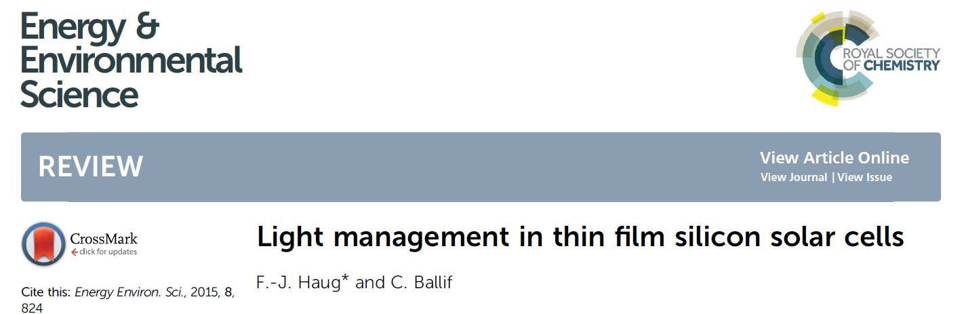

Slide 3
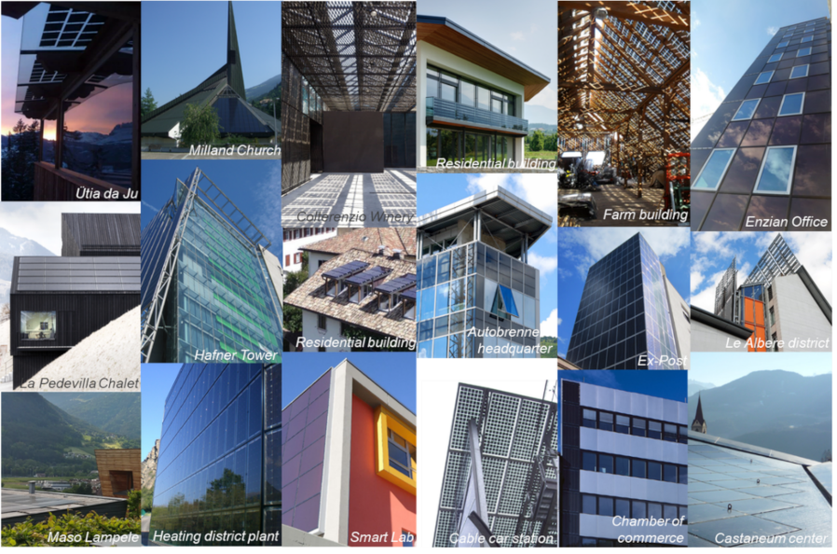
Thin film solar cells
2nd generation solar cells
Thin films: cheaper materials, less materials, can be made flexible and/or semi-transparent, can be integrated in buildings/vehicles/...
Thickness of the active layer ~ µm
3 main commercially available technologies: a-Si:H, Cu(In,Ga)Se₂ and CdTe
1 emerging technology: perovskite
https://www.buildup.eu/sites/default/files/illustrations/bipvao2.png

Slide 4
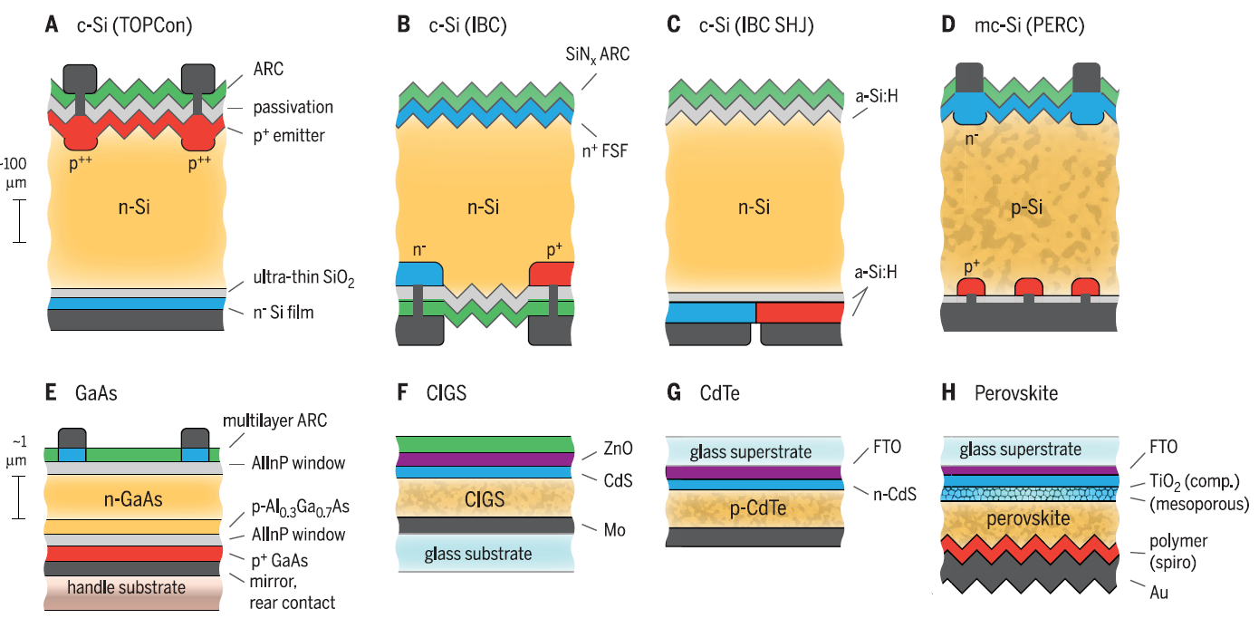
Thin film solar cells
Si vs thin film
Si PV is based on wafers of about 200 µm thick
Thin films are deposited on carriers
Glass, plastics, metal foils

Slide 5
Thin film solar cells
Substrate / superstrate
Glass, plastic, metal sheets
TCO: transparent conductive oxide = front contact (back-contact for bi-facial cells)
Metal: back contact
Deposition techniques: chemical or physical vapour deposition, wet processing
Absorber layer: CIGS or intrinsic a-Si:H = active layer where electron-hole pairs are generated
Separation of carriers happen at the hole and electron contacts

Slide 6
Thin film solar cells
superstrate
Transparent conductive layer
Transparent conductive layer
n-type CdS
p-type a-Si:H
Electron contact
p-type Cu(In,Ga)Se2 (absorber layer)
2-3 µm
Hole contact
Intrinsic a-Si:H
(absorber layer)
200 - 400 nm
Electron contact
Hole contact
n-type a-Si:H
Metal contact
Metal contact
substrate

Slide 7
Thin film solar cells
a-Si:H: One of the first commercially available thin film solar technology. They have an unavoidable problem related to the amourphous material: it is unstable over time (Steabler Wronski effect). Making the layer thinner, reduces this degradation. Thickness of a-Si:H layer: 200 - 400 nm. Too thin to absorb all the light → light management techniques using micro-structures
Cu(In,Ga)Se₂: one of the most effecient thin film solar cell technology. For large scale application, the element Indium (In) causes concern due to the multiple usage in electronics generally (i.e. touch screens). Thickness of CIGS layer in commerical solar panels: 2-3 µm → ultrathin (~500 nm) CIGS in development → passivation and light management required

Slide 8
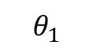
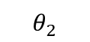
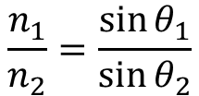
Short introduction optics
Light and interaction with matter
Refractive index
Complex number: N = n + ik
Real n: refractive index
Complex k: extinction coefficient
Light diffraction
Snellius’ law
Air
n₁ = 1
CIGS
n₂ ~ 3
https://en.wikipedia.org/wiki/Diffuse_reflection

Slide 9
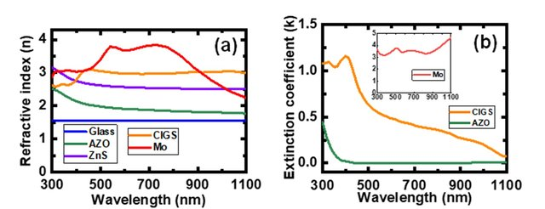
Short introduction optics
Light and interaction with matter
Refractive index
Complex number: N = n + ik
Real n: refractive index
Complex k: extinction coefficient
https://en.wikipedia.org/wiki/Diffuse_reflection

Slide 10
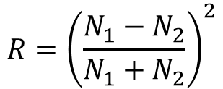
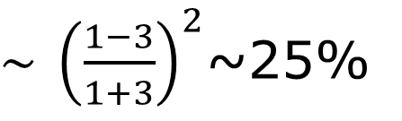
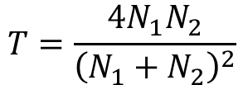
Short introduction optics
Light and interaction with matter
Refractive index
Complex number: N = n + ik
Reflection and transmission
Perpendicular incindence
Air
n₁ = 1
CIGS
n₂ ~ 3

Slide 11
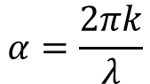
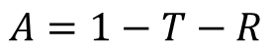
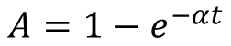
Short introduction optics
Light and interaction with matter
Refractive index
Complex number: N = n + ik
Absorption coëfficiënt
λ
λ is the wavelength of the light
Air
n₁ = 1
CIGS
n₂ ~ 3
t is the thickness of the medium the light is traveling through

Slide 12
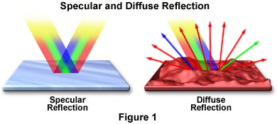
Short introduction optics
Light and interaction with matter
Diffuse and specular reflection
Mirror
White wall
https://www.olympus-lifescience.com/en/microscope-resource/primer/java/reflection/specular/

Slide 13


Short introduction optics
Light and interaction with matter
Diffuse and specular reflection
Specular reflection
Diffuse reflection
https://www.olympus-lifescience.com/en/microscope-resource/primer/java/reflection/specular/

Slide 14
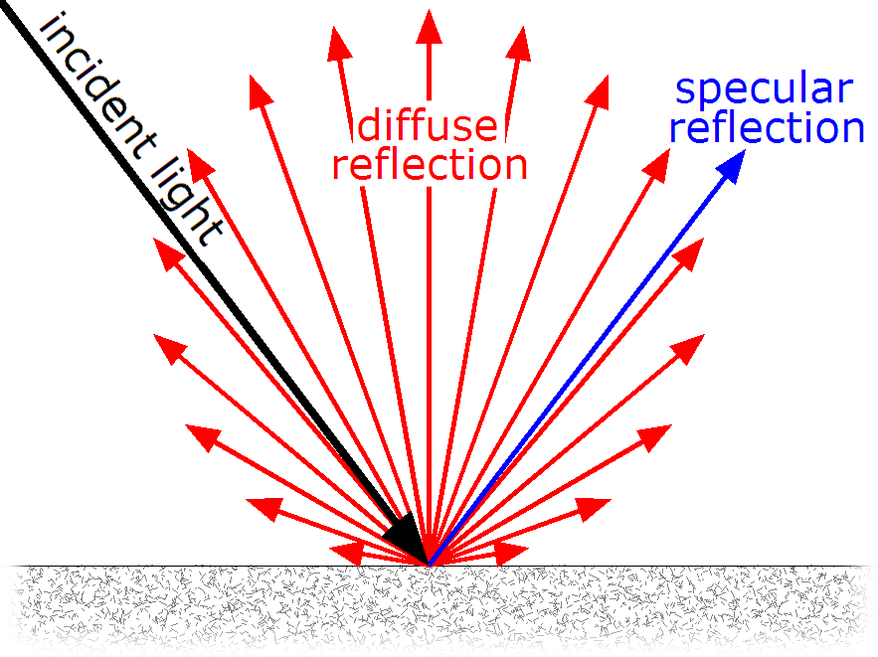
Short introduction optics
Light and interaction with matter
Diffuse and specular reflection
Scattering
https://en.wikipedia.org/wiki/Diffuse_reflection

Slide 15
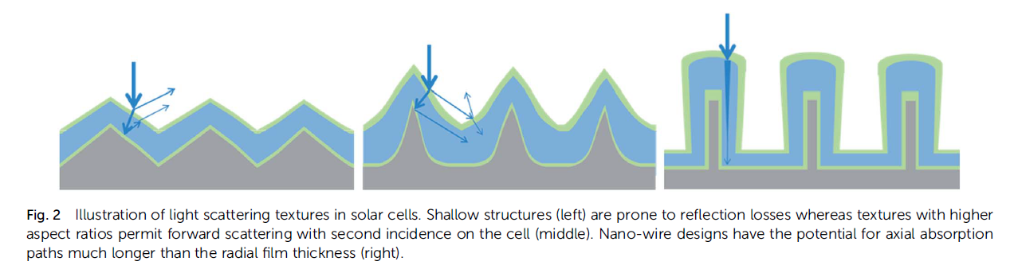
Optical losses
Not all incoming light will be absorbed:
Reflected or absorbed in inactive layers at the front → TCO’s and anti-reflection coating
Insufficient absorption in active layer → Light scattering and back reflection
https://doi.org/10.1038/s41560-020-00714-4

Slide 16
Optical losses
superstrate
Transparent conductive layer
Inactive layers (do not generate current)
Transparent conductive layer
n-type CdS
p-type a-Si:H
p-type Cu(In,Ga)Se₂ (absorber layer)
2-3 µm
Intrinsic a-Si:H
(absorber layer)
200 - 400 nm
n-type a-Si:H
Metal contact
Metal contact
substrate

Slide 17
Anti-reflection coating
superstrate
Transparent conductive layer
Transparent conductive layer

Slide 18
Anti-reflection coating
superstrate
Transparent conductive layer
Transparent conductive layer

Slide 19
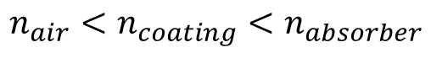
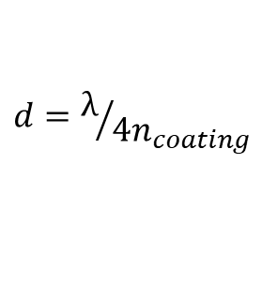
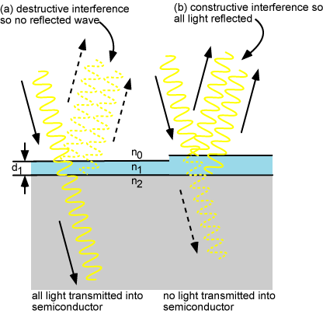
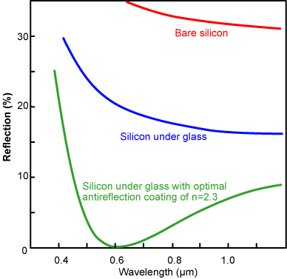
Anti-reflection coating
Matching refractive indices to decrease reflection at the front

Slide 20
Transparent conductive layers
superstrate
Transparent conductive layer
Transparent conductive layer

Slide 21
Transparent conductive layers
Most used:
ITO: In₂O₃/SnO₂
AZO: ZnO/Al
TCO: Transparent Conductive Oxide
Conductive materials: metals
Transparent materials: plastics and glass
Having both is actually kind of special
Labo2: optical and electrical properties of ITO, ZnO and etched ZnO

Slide 22
Sheet resistivity
Conductivity
Free carriers (most often electrons e⁻ in the conduction band)
Mobility of the free carriers (µ_{e}) (cm²/(Vs))
Concentration of the free carriers (n) (cm⁻³)
Conductivity σ = e⁻nµ_{e}
https://www.vonardenne.biz/en/company/press-events/industrial-tcos-for-shj-solar-cells/

Slide 23
Sheet resistivity
Conductivity
Free carriers (most often electrons e⁻)
Mobility of the free carriers (µ_{e})
Concentration of the free carriers (n)
Conductivity σ = e⁻nµ_{e}
A
Conductivity = σ (S/m)
Resistivity = ρ = 1/ σ (Ωm)
Resistance= R = ρ·t/A (Ω/m)
Sheet resistivity = R_{s} = ρ/t (Ω/sq)
t
https://www.vonardenne.biz/en/company/press-events/industrial-tcos-for-shj-solar-cells/

Slide 24
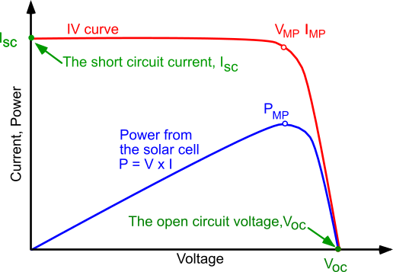
Sheer resistivity
Resistance in solar cell
Voltage losses V_{loss} = IR
Fill factor losses → squareness of the JV curve

Slide 25
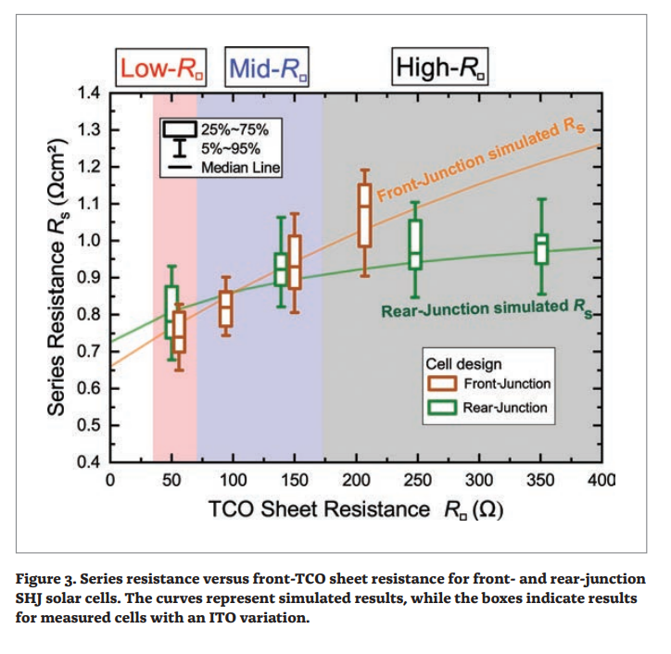
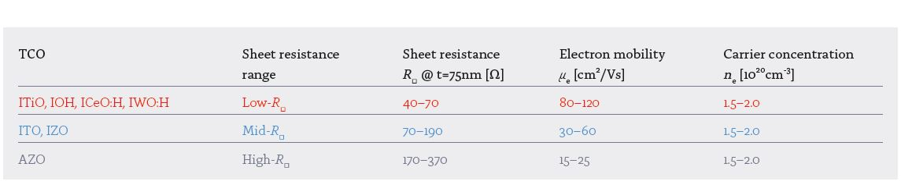
Sheet resistivity
https://www.vonardenne.biz/en/company/press-events/industrial-tcos-for-shj-solar-cells/

Slide 26
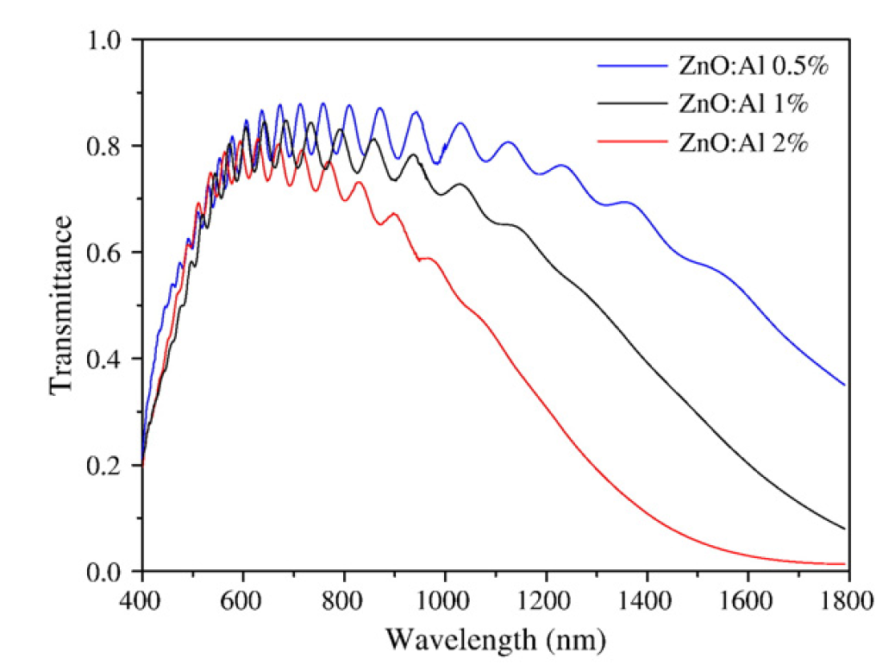
Transparency
Free carriers tend to absorb light
→ low concentration of carriers and high mobility
More Al, more free carriers, less transparent
→ Losses of incoming light

Slide 27
Optical losses
superstrate
Transparent conductive layer
Transparent conductive layer
n-type CdS
p-type a-Si:H
p-type Cu(In,Ga)Se2 (absorber layer)
2-3 µm
Intrinsic a-Si:H
(absorber layer)
200 - 400 nm
500 nm
n-type a-Si:H
Metal contact
Metal contact
substrate

Slide 28
Absorption
How much light is absorbed, depends on the thickness of the layer
For CIGS:
2 µm

Slide 29
Absorption
How much light is absorbed, depends on the thickness of the layer
For CIGS:
500 nm

Slide 30
Light management
Light scattering and back reflection: lengthen optical path is absorber layer
Increased path length:
More light is absorbed

Slide 31
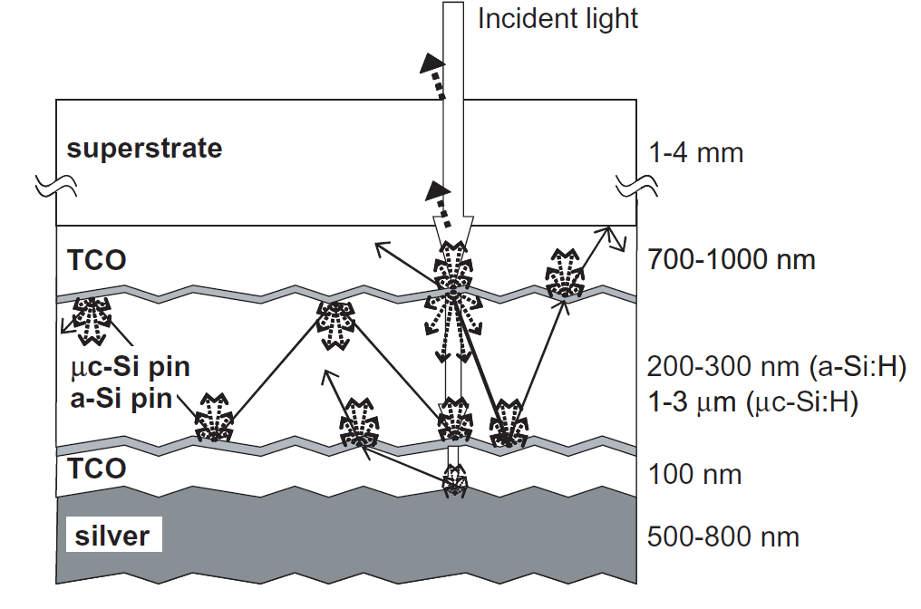
Light management
Light scattering incoming light: lengthen optical path is absorber layer

Slide 32
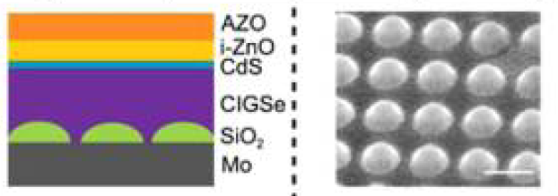
Light management
Back reflector: reflect light back into the absorber layer

Slide 33
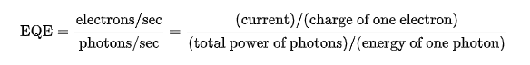
Quantum efficiency
How to determine the increased path length?
Increase pathlength should lead to increased current generation
Usually the absorbance of longer wavelength are increased
External Quantum Efficiency (EQE) measurements are good tool to determine increased absorption
https://en.wikipedia.org/wiki/Quantum_efficiency

Slide 34
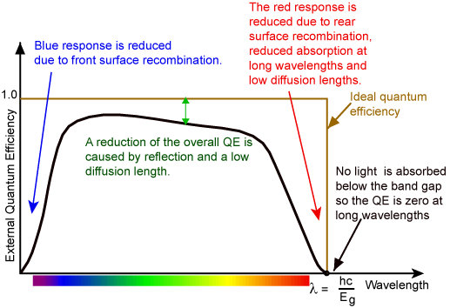
Quantum efficiency
https://www.pveducation.org/pvcdrom/solar-cell-operation/quantum-efficiency

Slide 35
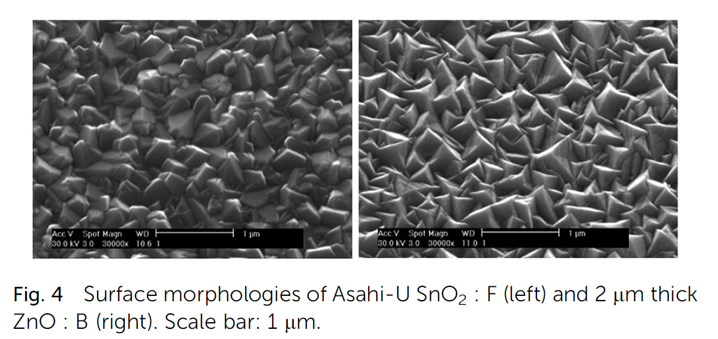
Light scattering
superstrate
TCO: random growth of crystals
Transparent conductive oxide
p-type a-Si:H
Intrinsic a-Si:H
(absorber layer)
500 nm
n-type a-Si:H
Metal contact

Slide 36
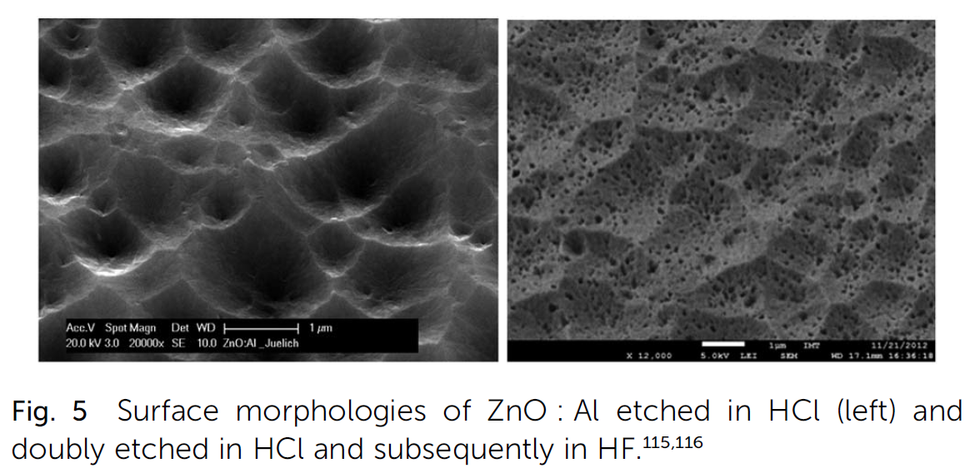
Light scattering
superstrate
TCO: etching
Transparent conductive oxide
p-type a-Si:H
Intrinsic a-Si:H
(absorber layer)
500 nm
n-type a-Si:H
Metal contact

Slide 37
Back reflector
Increase the reflection at the back
Matching refractive indices
Low k materials: N = n + ik
N₂ low and k (absorption) low
When k is high → absorption
Metals: low n high k
Absorption of light instead of reflection
Intrinsic a-Si:H
(absorber layer)
500 nm
N₁
n-type a-Si:H
Metal contact
N₂

Slide 38
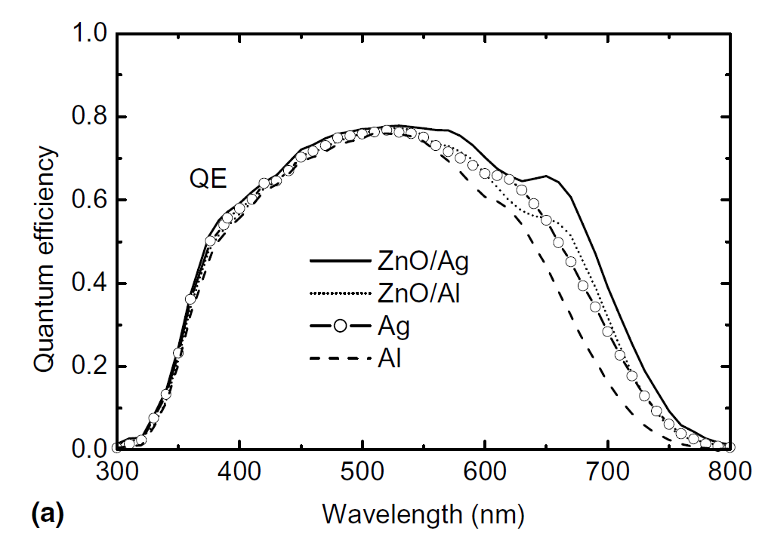
Back reflector
Increase the reflection at the back
Matching refractive indices
Low k materials: N = n + ik
N₂ low and k (absorption) low
Insertion of low k and low n layer (ZnO)
Intrinsic a-Si:H
(absorber layer)
500 nm
N₁
n-type a-Si:H
Metal contact
N₂
N₂

Slide 39
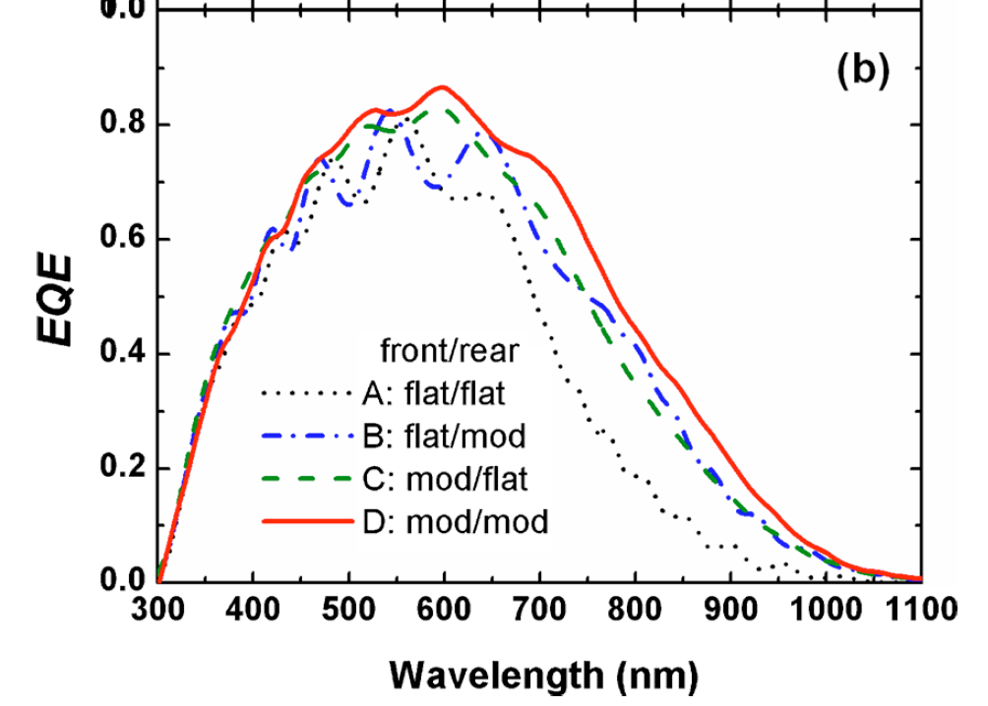
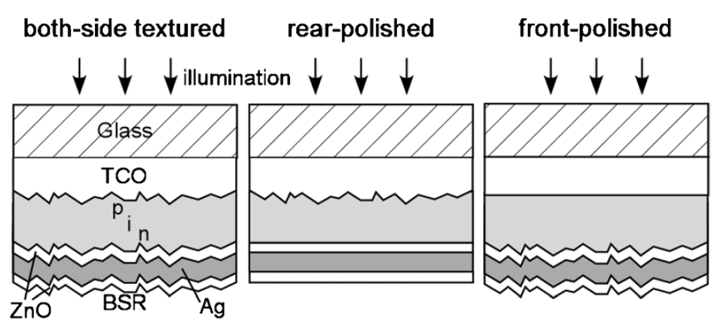
Thin film Si cells
Increase optical light path by scattering
Textured TCO layers
Impact of front and rear texture of thin-film microcrystalline silicon solar cells on their light trapping properties
Hitoshi Sai (齋均,a Haijun Jia (賈海軍, and Michio

Slide 40
Back reflector / light scattering in CIGS
Transparent conductive layer
n-type CdS
p-type Cu(In,Ga)Se2 (absorber layer)
500 nm
Due to deposition method, light management techniqes are generally applied at the back contact (and may also suffice as passivation)
Metal contact
substrate

Slide 41
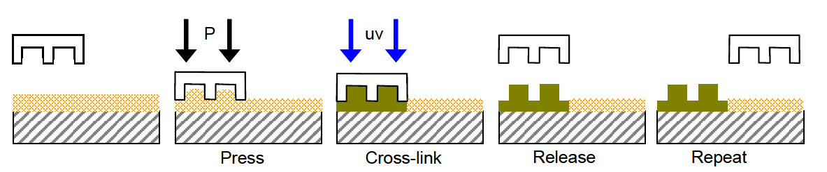
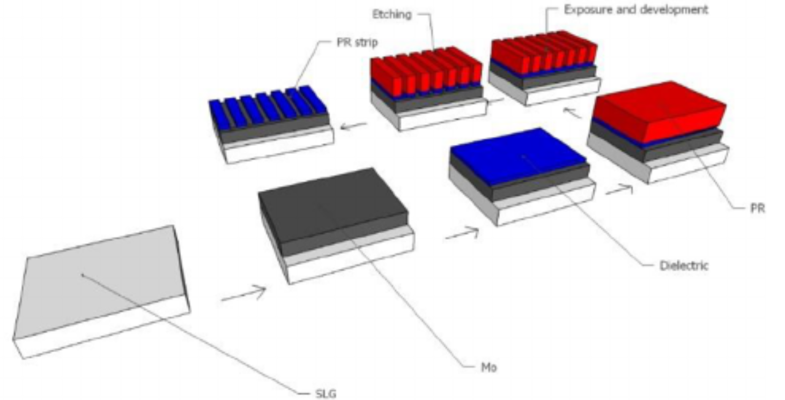
Method
Lithography:
Soft Nano-imprint
Mask
https://www.researchgate.net/publication/41834415_Substrate_conformal_imprint_lithography_for_nanophotonics
https://onlinelibrary-wiley-com.bib-proxy.uhasselt.be/doi/epdf/10.1002/solr.201800212

Slide 42
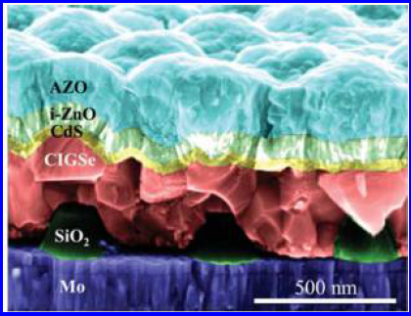
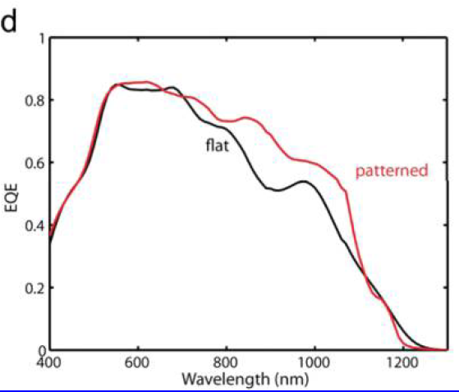
Light management in CIGS
Imprinting:
SiO₂ is a dielectric and also has passivating properties → contact with Mo required
10.1021/acsnano.5b04091

Slide 43
Metallic nanoparticles
Particle absorbs and re-emits light → spherical emitter
Wavelength of highly scattered light depends on the particles size
Particle size with circumference 2πr
Wavelength λ

Slide 44
Metallic nanoparticles
Particle absorbs and re-emits light → spherical emitter
Wavelength of highly scattered light depends on the particles size
Particle size with circumference 2πr
Wavelength λ

Slide 45
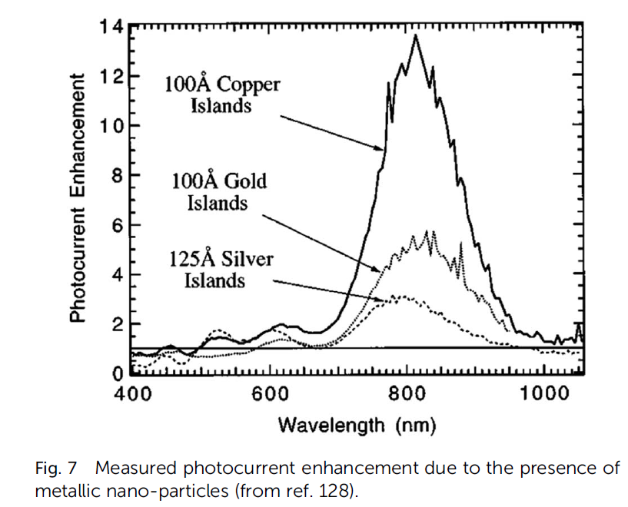
Metal nanoparticles
Small metal nanoparticles have high scattering properties

Slide 46
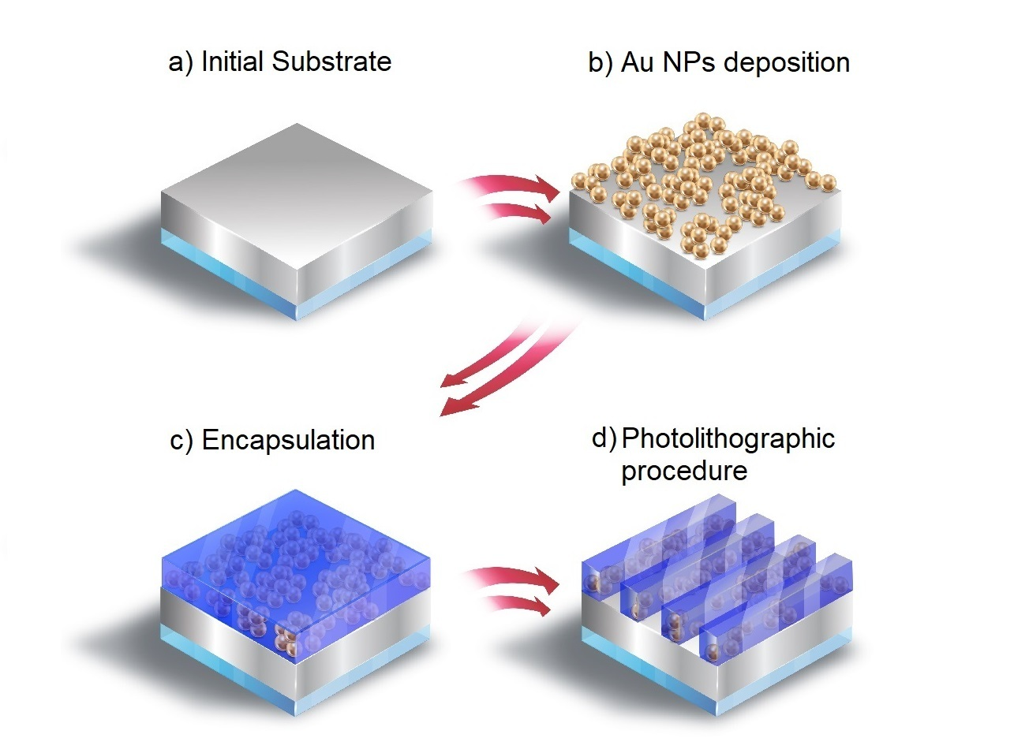
Method
Gold nanoparticles encapsulated in AlO_{x}
AlO_{X} is also a dielectric with very good passivating properties

Slide 47
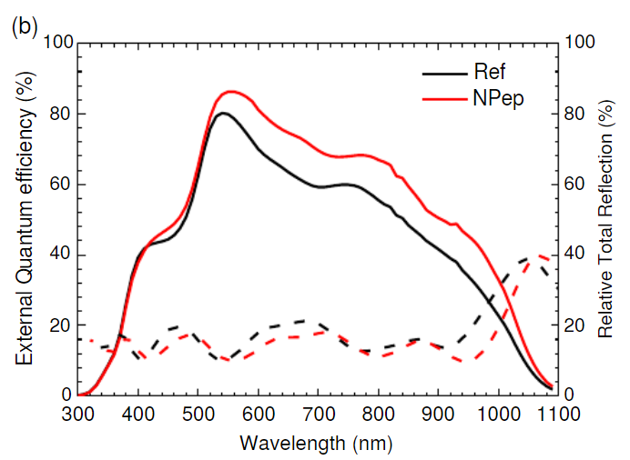
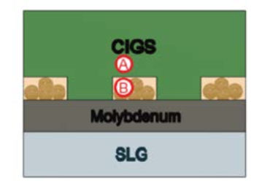
Light management in CIGS
Al2O3 → passivation and encapsulation
Gold nanoparticles → light scattering particles

Slide 48
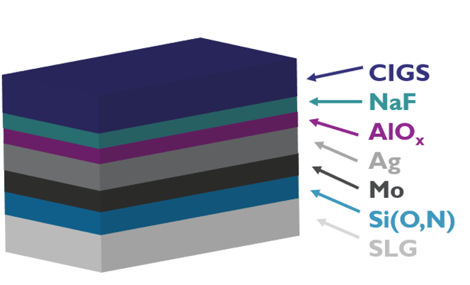
Light management in CIGS
Light scattering by thermally induced roughness
During CIGS growth, the thin Ag and AlOx layers react with the CIGS layer and induce roughness at the back

Slide 49
Light management in CIGS
Ag/AlOx: During CIGS growth, the thin Ag and AlOx layers break and induce roughness at the back
p-type Cu(In,Ga)Se2 (absorber layer)
500 nm
Metal contact
substrate

Slide 50
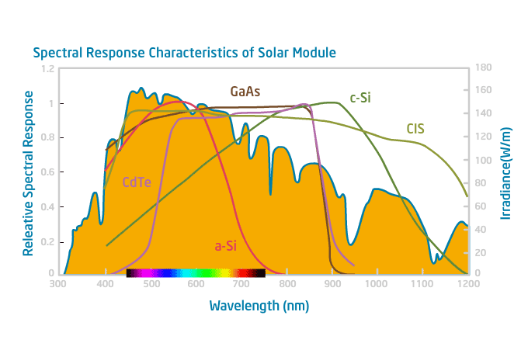

Beyond single junction solar cells
Shockley Queisser Limit: maximum conversion energy depending on the band gap of single junction solar cell
Photovoltaic materials: Present efficiencies and future challenges DOI: 10.1126/science.aad4424

Slide 51
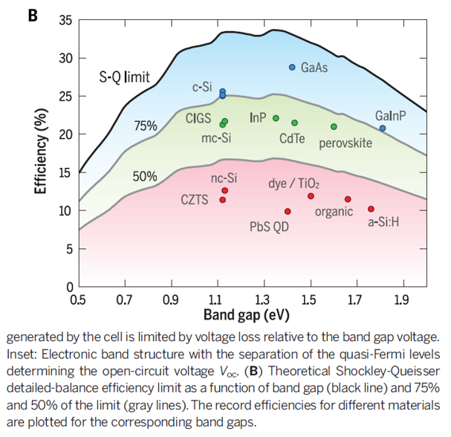
Beyond single junction solar cells
Schockley Queisser Limit: maximum conversion energy depending on the band gap of single junction solar cell
Maximum 33% can be converted into electric power
Photovoltaic materials: Present efficiencies and future challenges DOI: 10.1126/science.aad4424

Slide 52
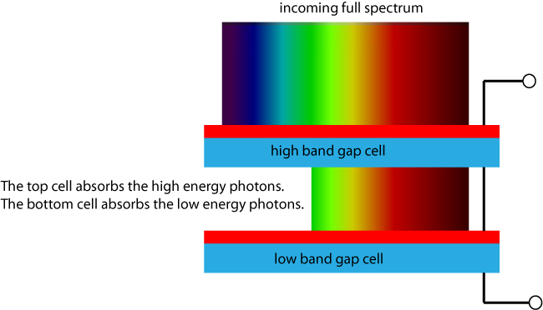
Beyond single junction solar cells
Increasing efficiency further:
Tandem solar cells: stacked solar cells with different band gaps
https://www.pveducation.org/pvcdrom/tandem-cells
https://www.pveducation.org/pvcdrom/tandem-cells

Slide 53
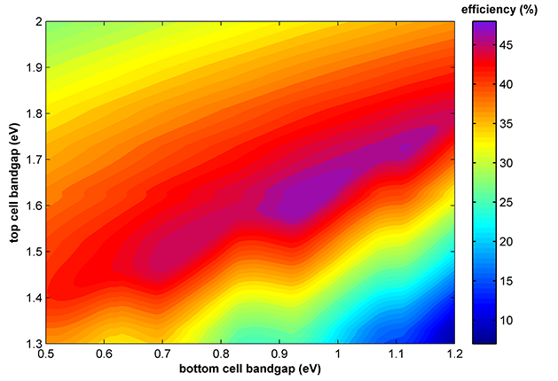
Beyond single junction solar cells
Increasing efficiency further:
Tandem solar cells: stacked solar cells with different band gaps
https://www.pveducation.org/pvcdrom/tandem-cells

Slide 54
Tandem structures
Tandem solar cells: Si + high band gap thin film solar cell
Photovoltaic materials: Present efficiencies and future challenges DOI: 10.1126/science.aad4424

Slide 55
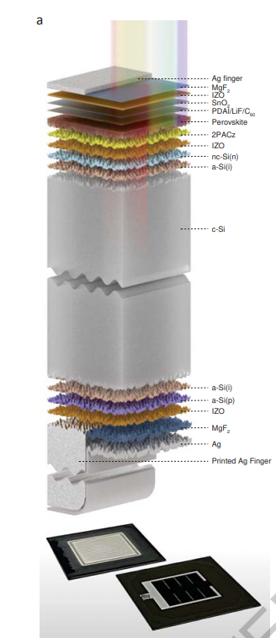
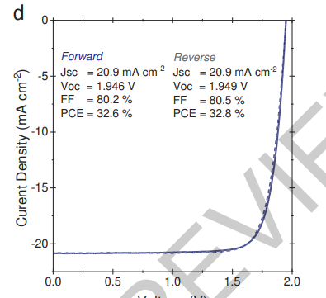
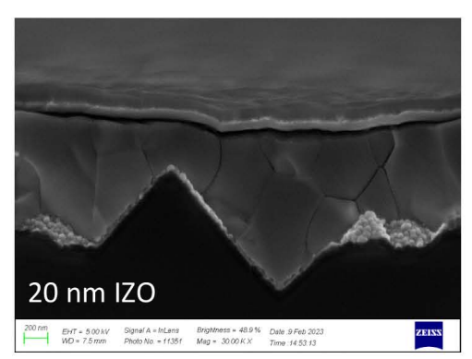
Tandem structures
Perovskite / Si wafer
Pk band gap ~ 1.6 eV, deposition on top of Si wafer
Record tandem cell 32.5%
Published: 28 September 2023
Enhanced optoelectronic coupling for perovskite-silicon tandem solar cells

Slide 56
Thin film solar cells
superstrate
Transparent conductive layer
Transparent conductive layer
p-type a-Si:H
p-type a-Si:H
Intrinsic a-Si:H
(absorber layer)
200 - 400 nm
Intrinsic a-Si:H
(absorber layer)
200 - 400 nm
n-type a-Si:H
n-type a-Si:H
Metal contact
Metal contact
substrate
p-i-n
n-i-p

Slide 57
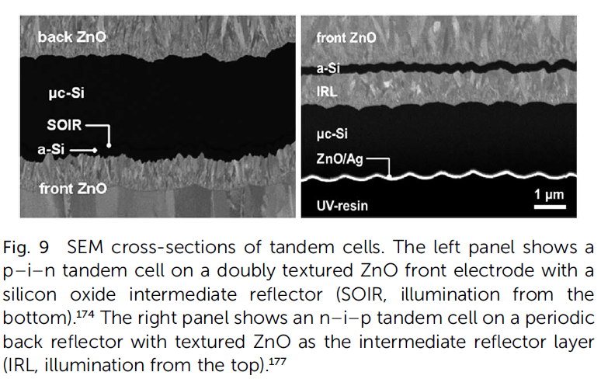
Tandem structures
Thin film Si tandem structures
a-Si:H band gap 1.7 eV, nc-Si band gap 1.1 eV

Slide 58

Tandem structures
Thin film Si tandem structures
a-Si:H band gap 1.7 eV, nc-Si band gap 1.1 eV
Deposition order depending sub- or superstrate configuration
Substrate: nip ns-Si, nip a-Si
Superstrate: pin a-Si, pin nc-Si,
Glass
Glass

Slide 59

Tandem structures
CIGS/perovskite
CIGS and gap ~1 eV, Pk band gap ~ 1.6 eV
Pk deposited on top of the CIGS layer after smoothening the ITO layer
Han et al., Science 361, 904–908 (2018) 31 August 2018

Slide 60
Take away messages
Basic working principle of solar cells
Si technology and thin film technology -> advantages and disadvantages of the different technologies
Use of various materials and layers (active layer = absorber layer, non-active layers = contacts, emitters)
Optical losses and how to deal with it
Concept of tandem cells
Next lectures: deposition techniques, characterization techniques, passivation & light management structures

Slide 61


Notes:
Take away massages: 2 different technologies: thin film and Si, Si: thick robust, highly efficient, reached its limit: thin film –new, more options, less efficient but faster and cheaper to make. Can be combined with SI in tandem technologie, can be flexible, semi-transparent. What is an absorber layer, what is a TCO, why do we need light absorption etc

